Slide 2
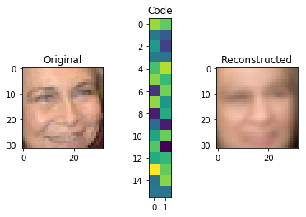
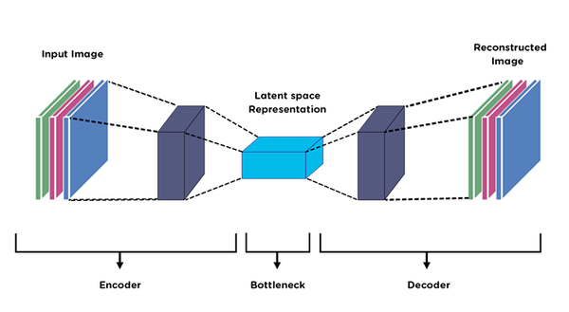

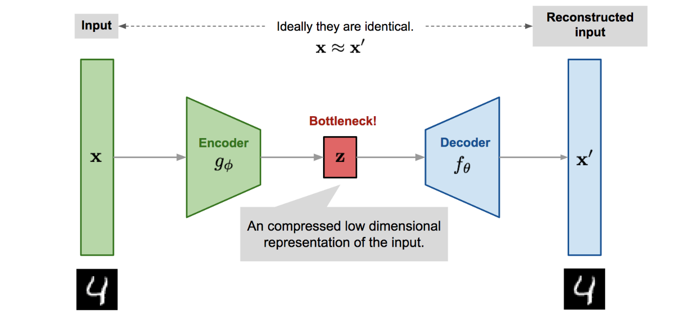
Autoencoder
Autoencoder use a different approach to solve neural network tasks. They usually try to reconstruct an e.g. an image through a bottleneck in the architecture. In CNN based Autoencoders the bottleneck is achieved by a series of downsampling (encoder) and upsamling /transposed convolutions (decoder)
transposed convolutions

Slide 3
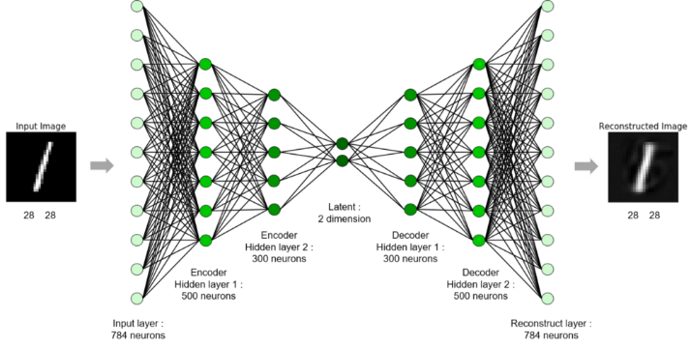
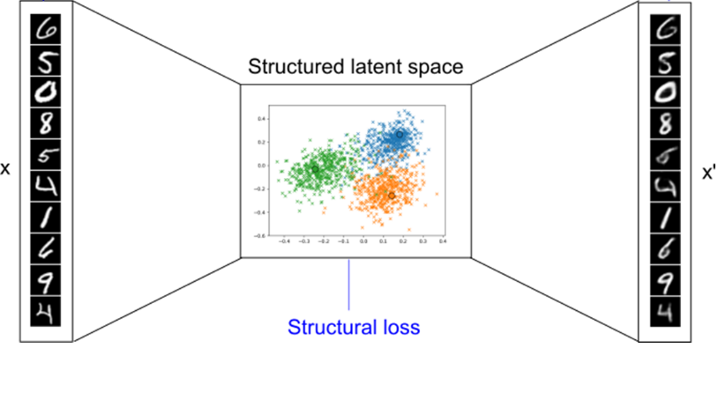
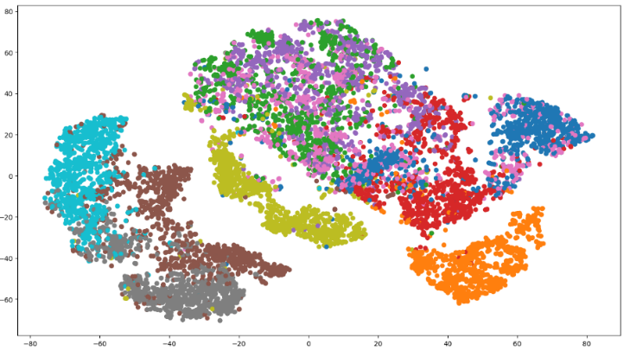
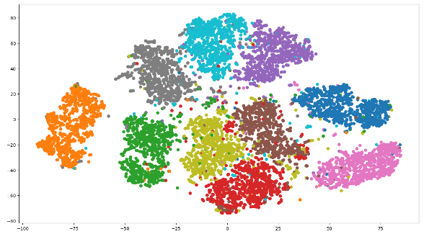
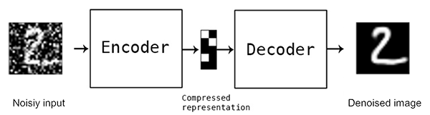
Autoencoder
The goal here is to receive a latent representation that best explains the data, requiring no supervised training at all! Autoencoder can be built by using many Neural Network types. Here we is one build up with standard Feed Forward Layers (e.g. Sigmoid Neurons)
t-SNE pre AE encoder
t-SNE post AE encoder
The data prio to the AE doesn’t look nice at all! But after passing the encoder it is well structured! We will replicate those plots in the next exercise. A typical use case of an Autoencoder is denoising!

Slide 4
10. Exercise Let‘s train our first Autoencoder for MNIST and FashionMNIST!

Slide 5
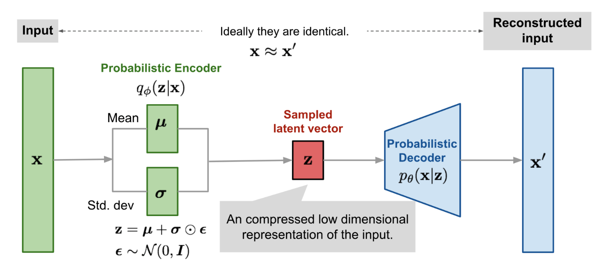
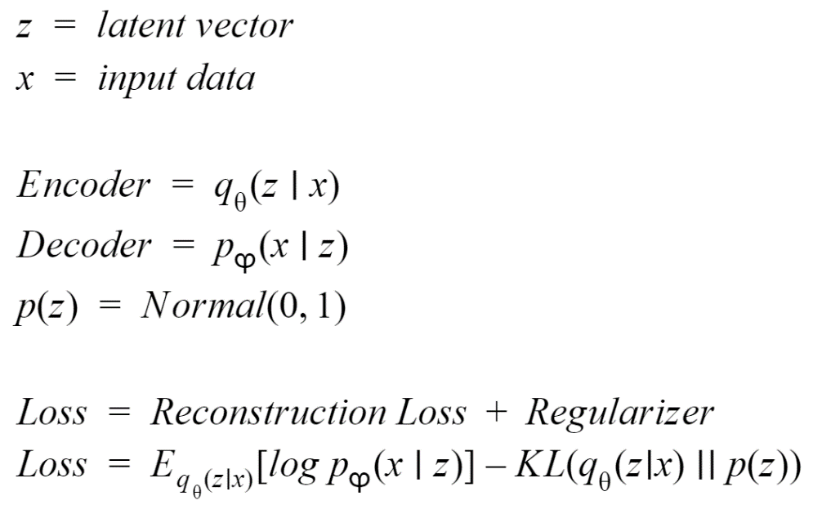
Variational Autoencoder
Generative modeling instead of discriminative! Autoencoder is trying to estimate mu and sigma of a distribution!
KL Divergence
Similarity of the Distributions
The VAE has 2 objectives: The reconstruction loss (our standard loss) needs to be small and the distribution of our latent needs to be as close to the data as possible! The similarity of the distributions is measured by the Kulbach-Leibler Divergence (KL)

Slide 6
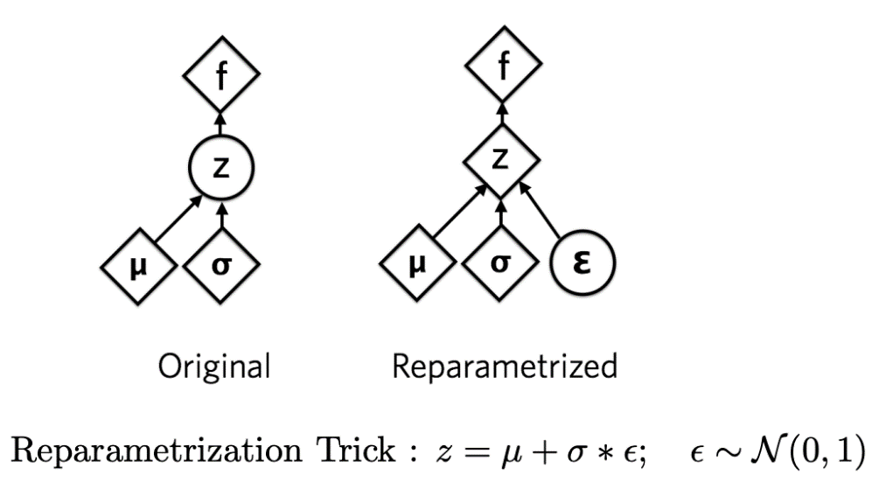
Variational Autoencoder Reparametrisation Trick
We can’t backprogate though this network anymore as we pleased in the past. We need to use the Reparametrisation Trick by Kingma to so, because we can’t backprop over a sampling process.
The trick is to factor out the sampling. Just multiplicate mu and sigma calculated by the network with a predefined (already sampled) image with mu =1 and sigma =0. The sampled image stay’s the same over the hole training process it is a dummy just scaled by the mu and sigma calculated by the network! ☺

Slide 7
11. Exercise Let‘s train our first Variational Autoencoder!

Slide 8
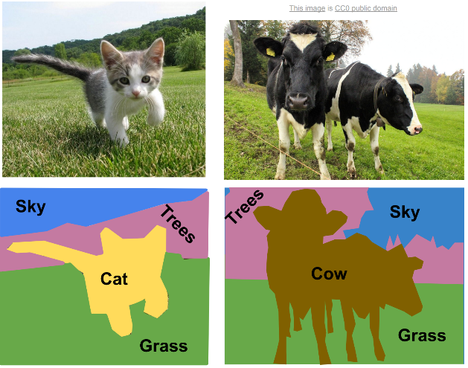
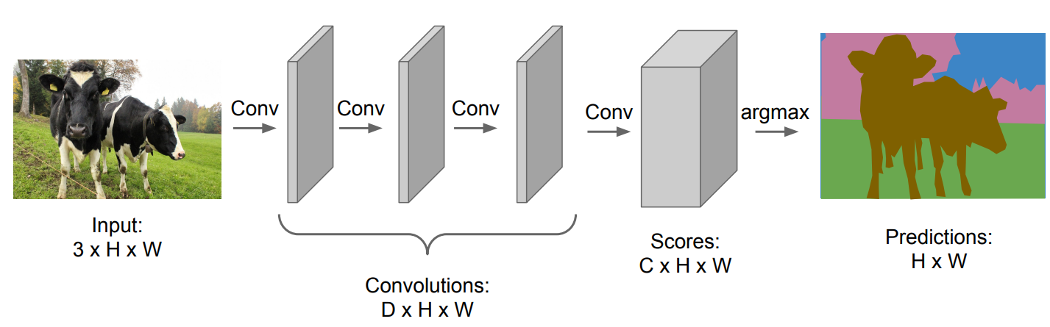
Image Segmentation
Today, Autoencoders have gained popularity in the task of Image Segmentation.
For this task, every pixel is labeled with a class label, e.g. cow, tree, grass sky or cat. Thus we do not care about detecting any object, only about the label of all the pixels of the image.
How about we train a fully convolutional network (=no MLP layer at the end) to make predictions for each pixel all at once? The problem with this approach is that (again) convolutions at the original image resolution will be very expensive and would take a lot of memory.

Slide 9
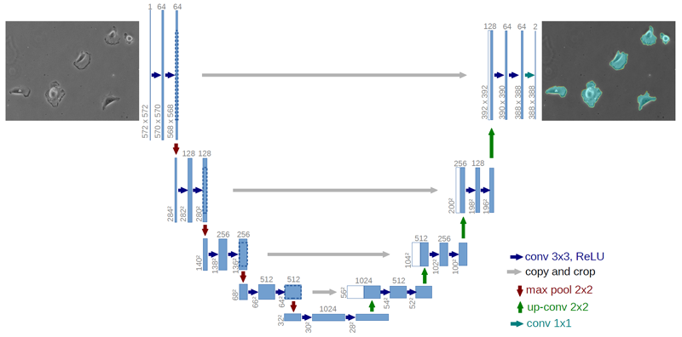
U-Net
Like an Conv. Autoencoder this architecture consists of a contracting path (encoder) to capture context and a symmetric expanding path (decoder). There are also short-cut paths which allows the network to propagate context information to higher resolution layers. But in contrast to the standard AE, U-Net uses a supervised mapping. The shape gives this network its U-Net name.
transposed convolutions

Slide 10
Extra If time, train U-Net for cell segmentation in Uni-Warwick dataset!

